Slide 1
Describe Monitorinę Toolsin Azure

Slide 2


^{In this module,} you'll be inti-oduccd to t:ools that hclg
you monitor your environ_{ment}
and a|3|3licatioi1s, l‹nI la
Azure acd in on-premises or multicloud envii co,iJnenr

Slide 3
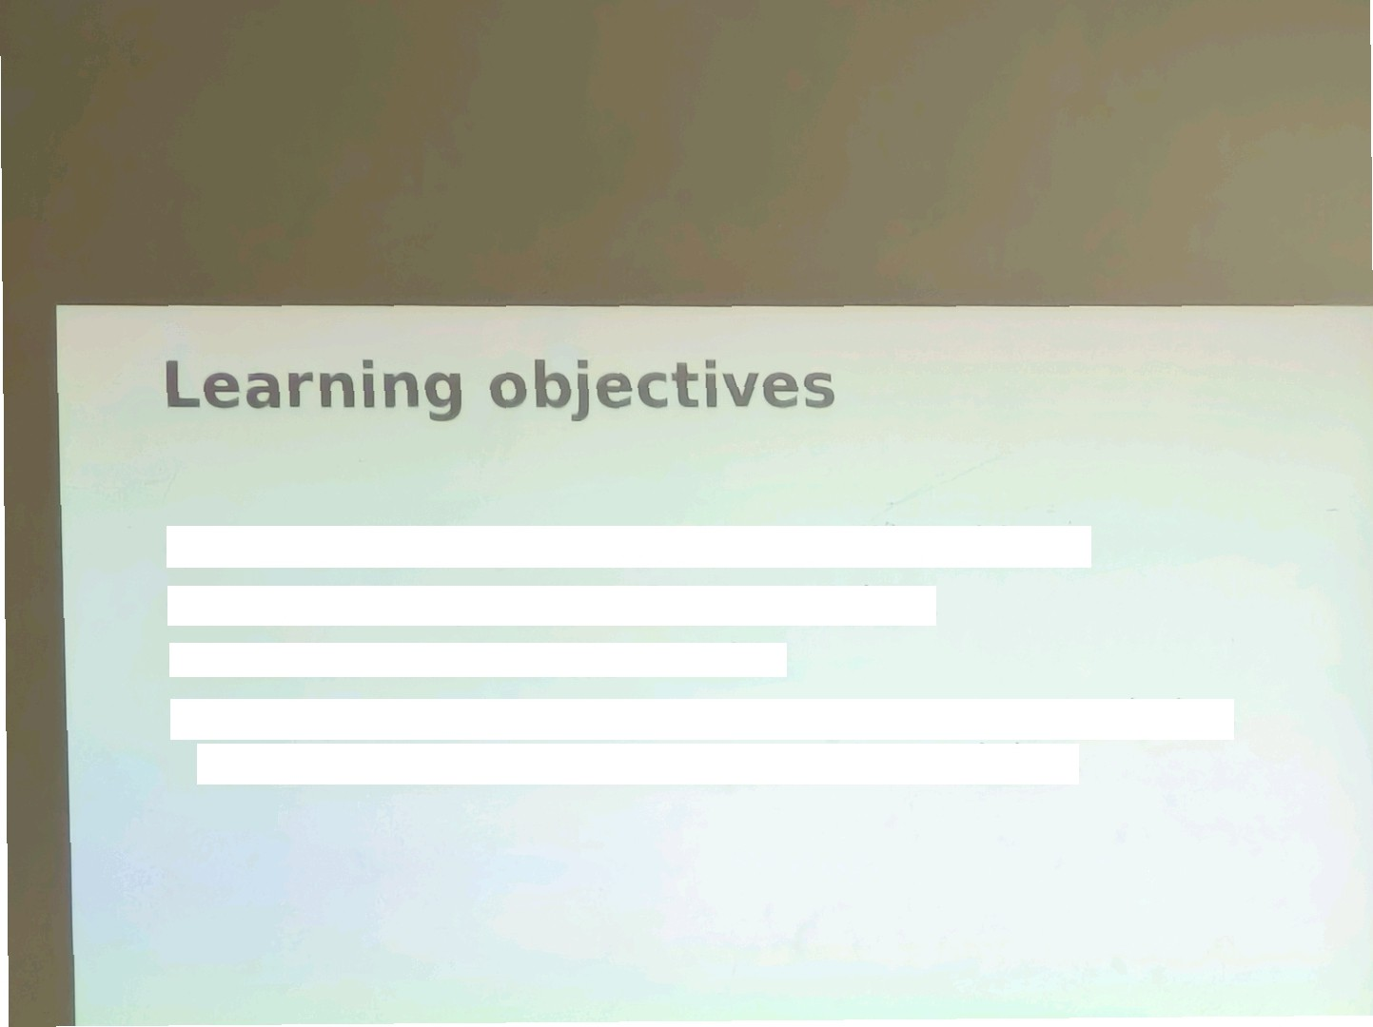
ARer completing this module, you'll be able to
Describe the purpose of Azure Advisor.
Describe Azure Service Health.
Describe Azure Monitor, inctuding Azure Log Ana|ytiCS,
Azure Monitor Alerts, and Application InSights

Slide 4
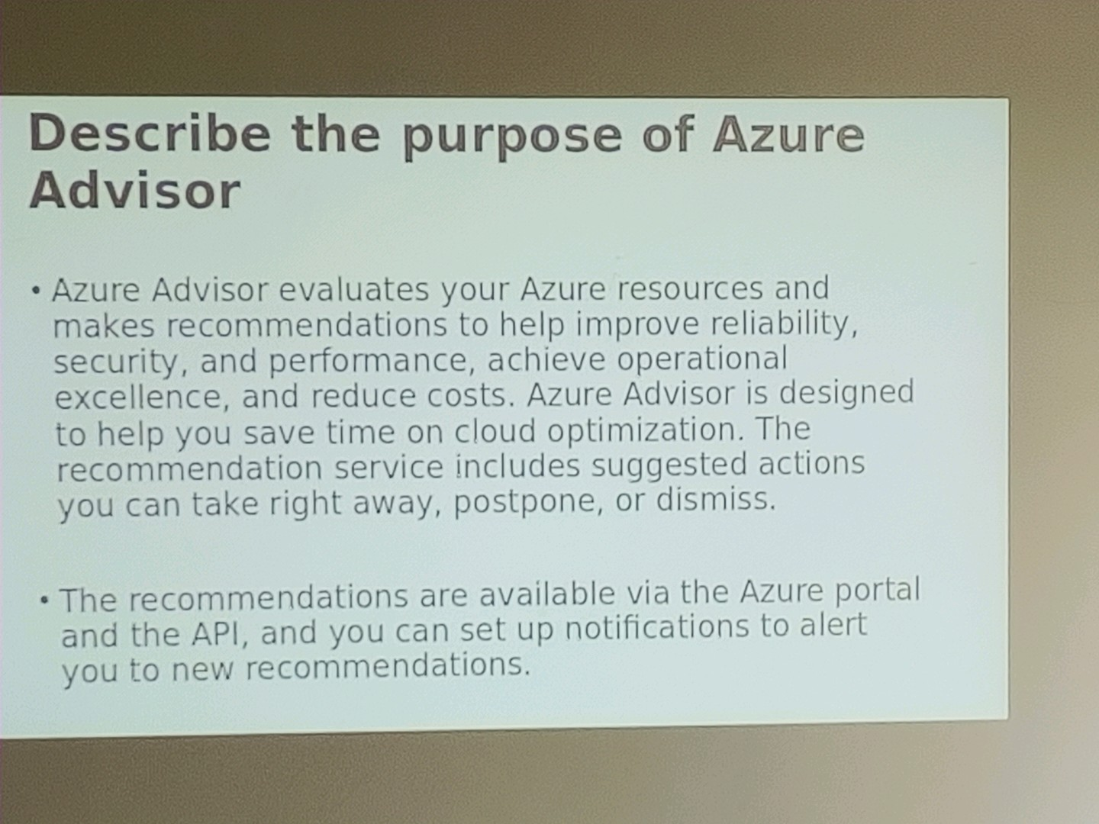

Slide 5
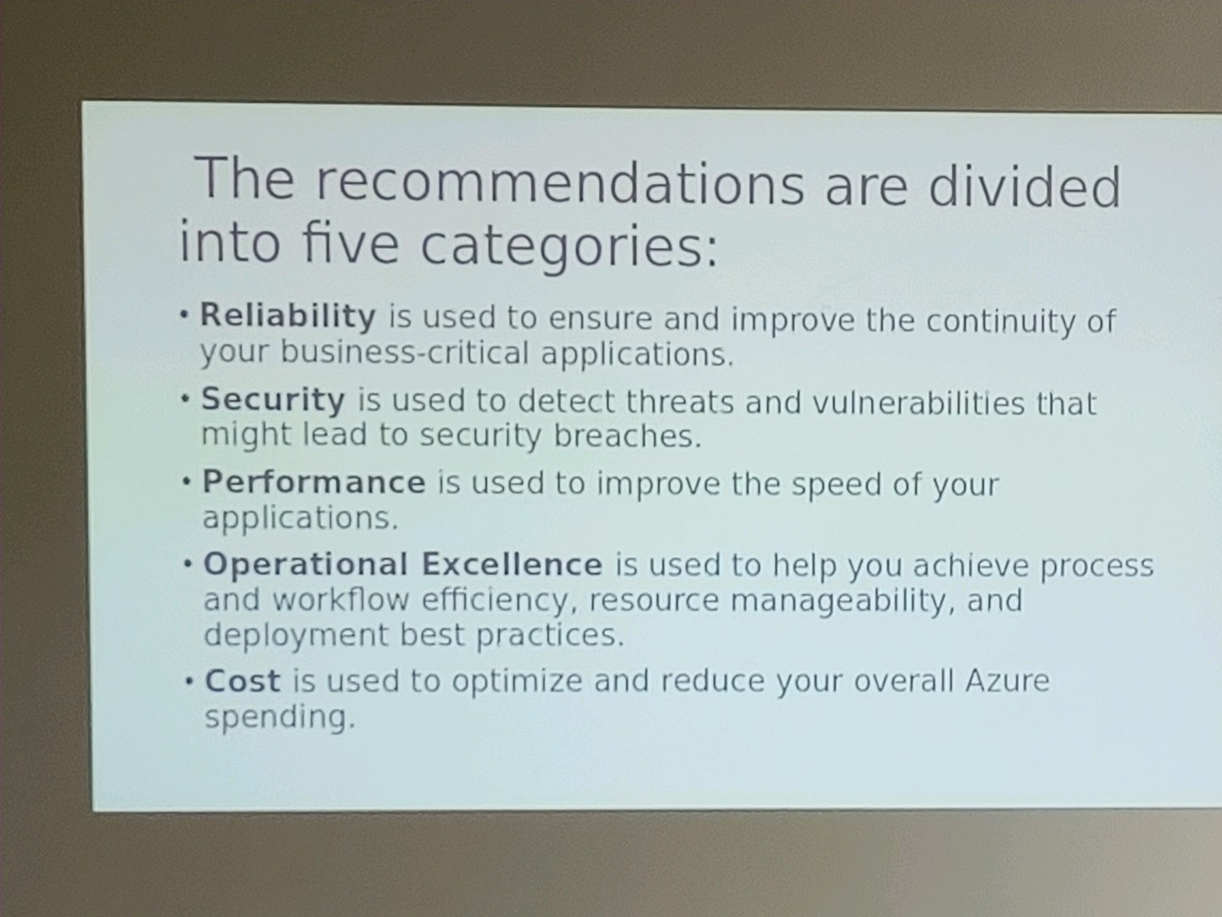

Slide 6
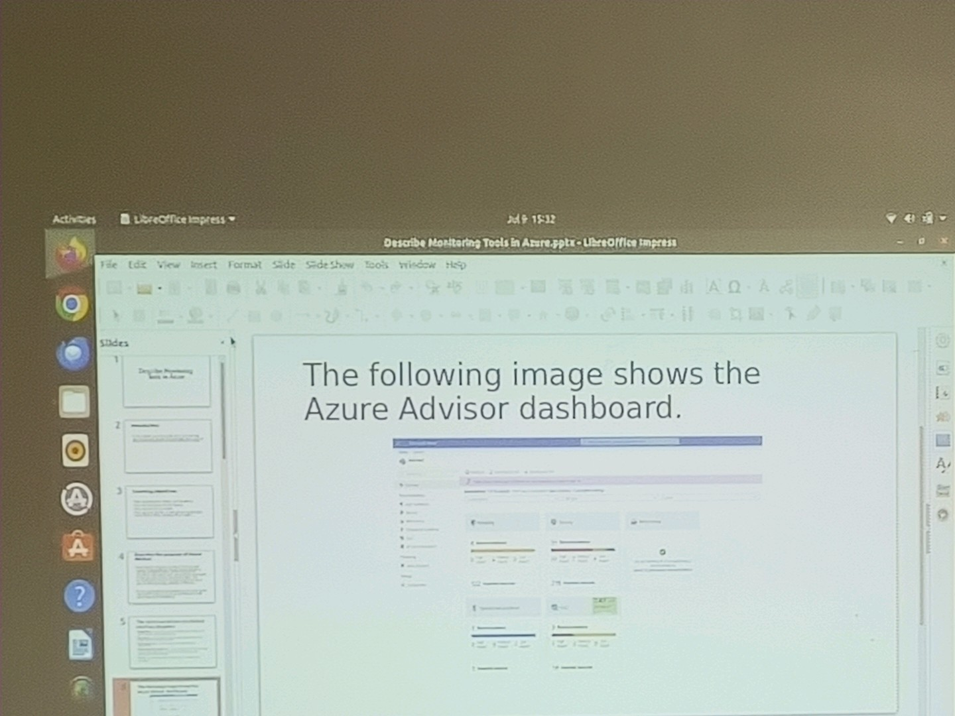

Slide 7
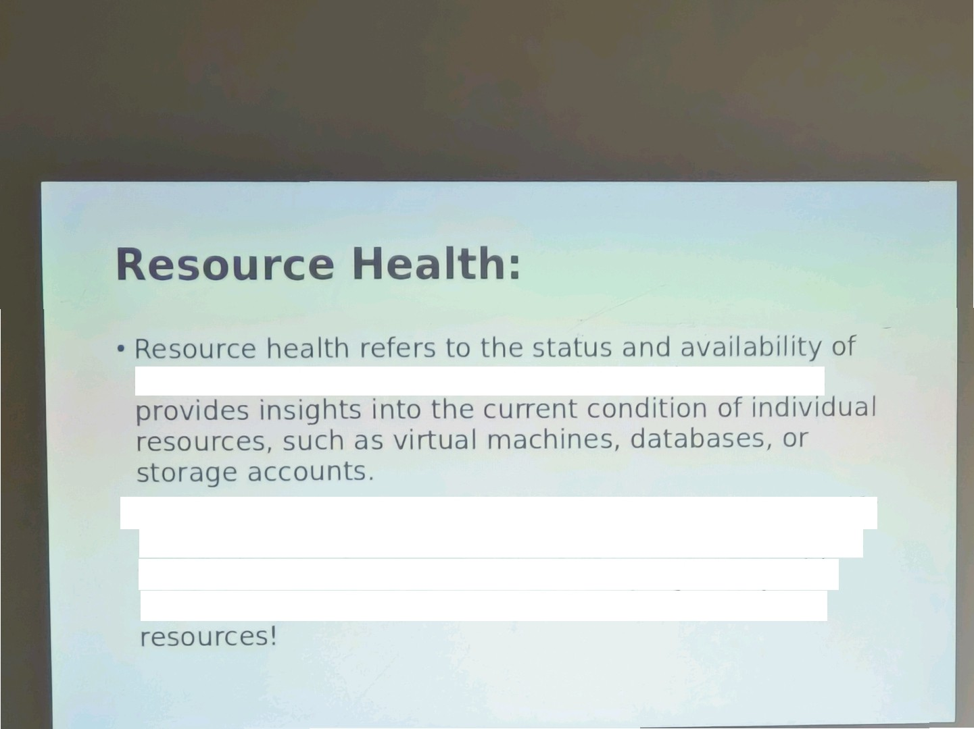
specific resources within your Azure environment. It
•
By monitoring resource health, you can quickly identify and address any issues or disruptions that may imgact the performance or availability of your resources, It's like having a health check-up for each of your Azure

Slide 8
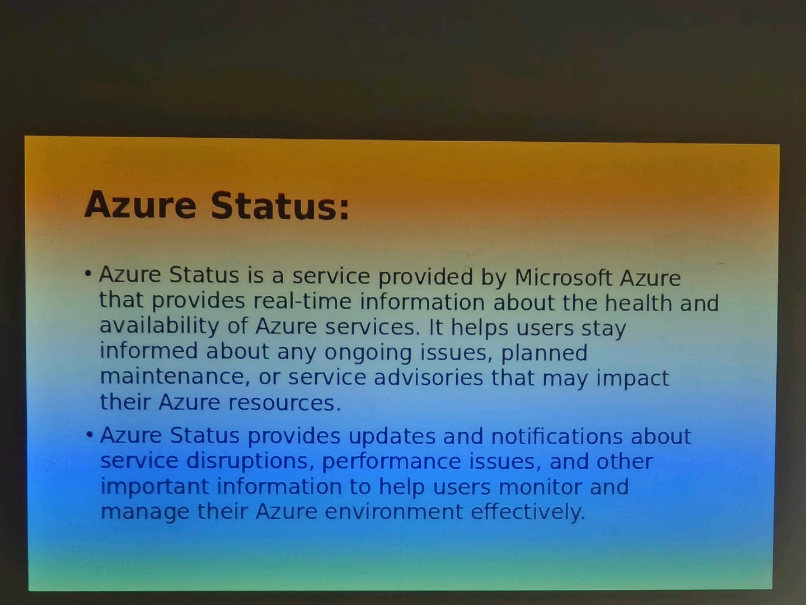

Slide 9
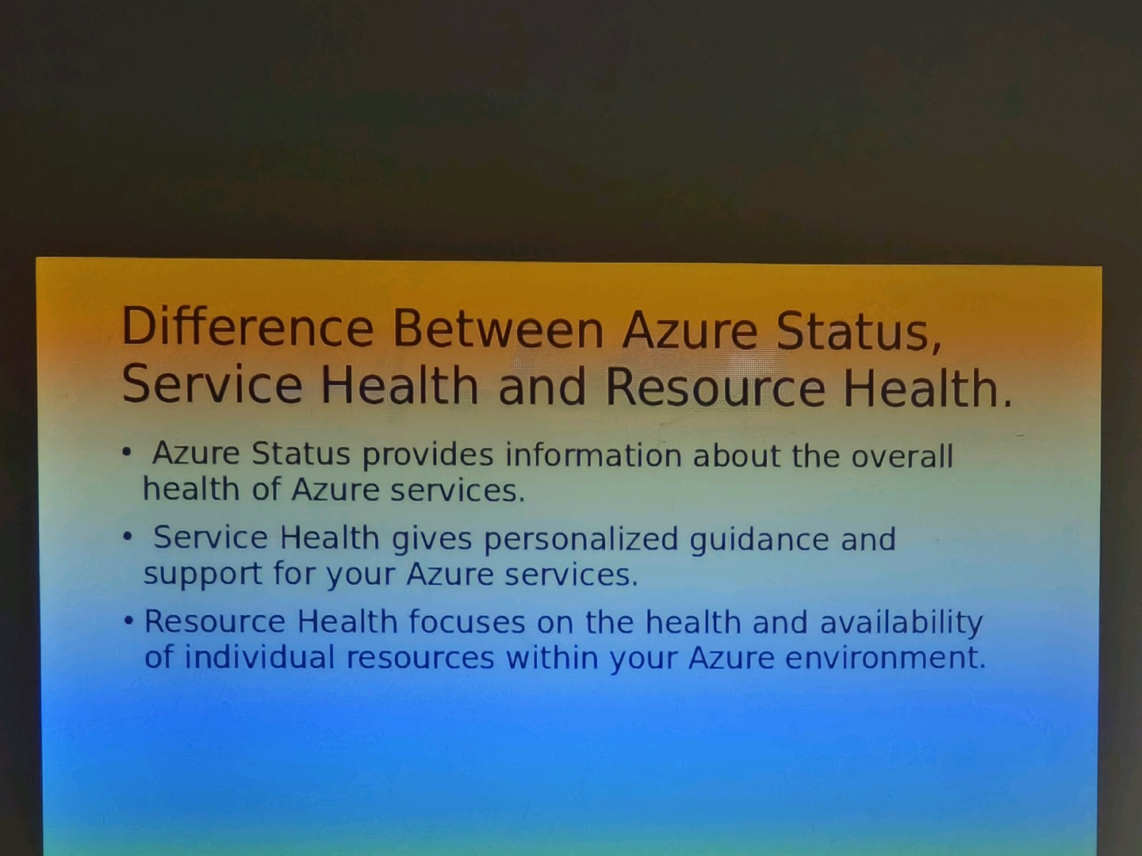

Slide 10
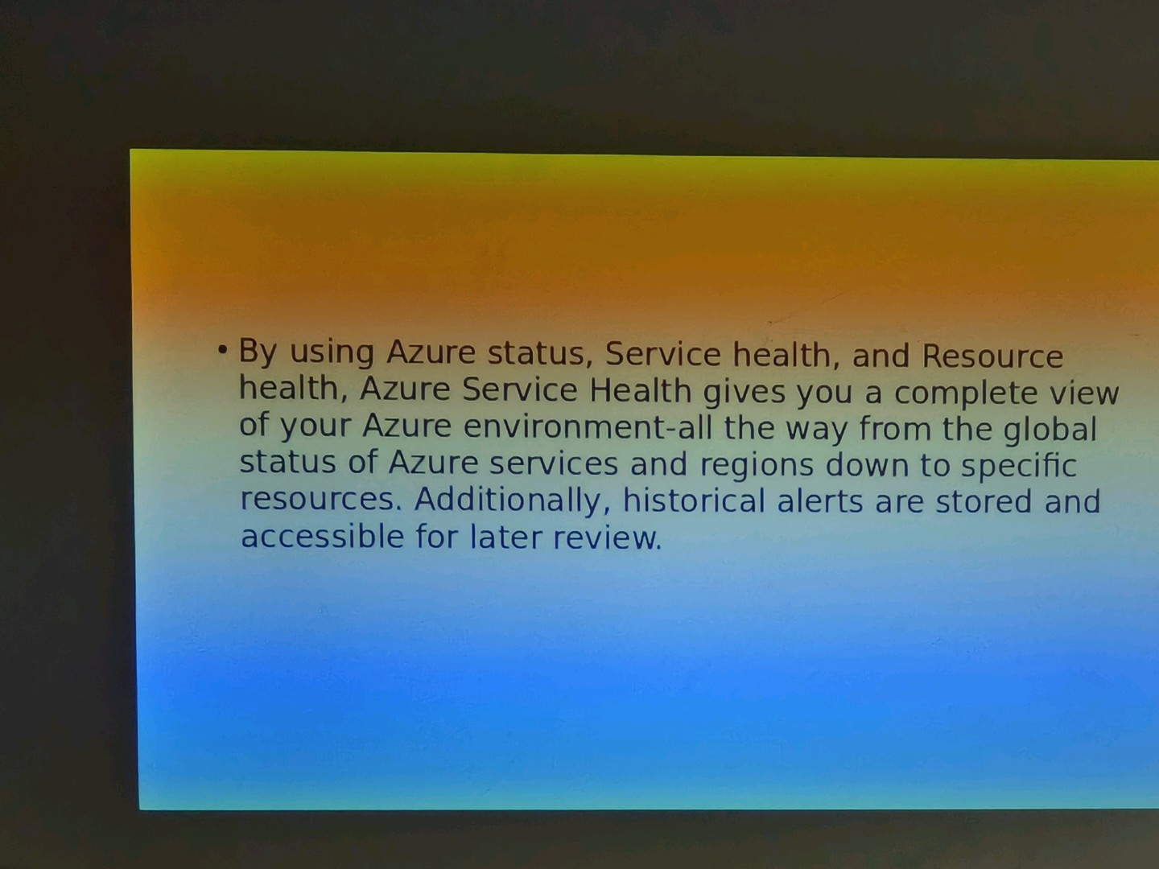

Slide 11
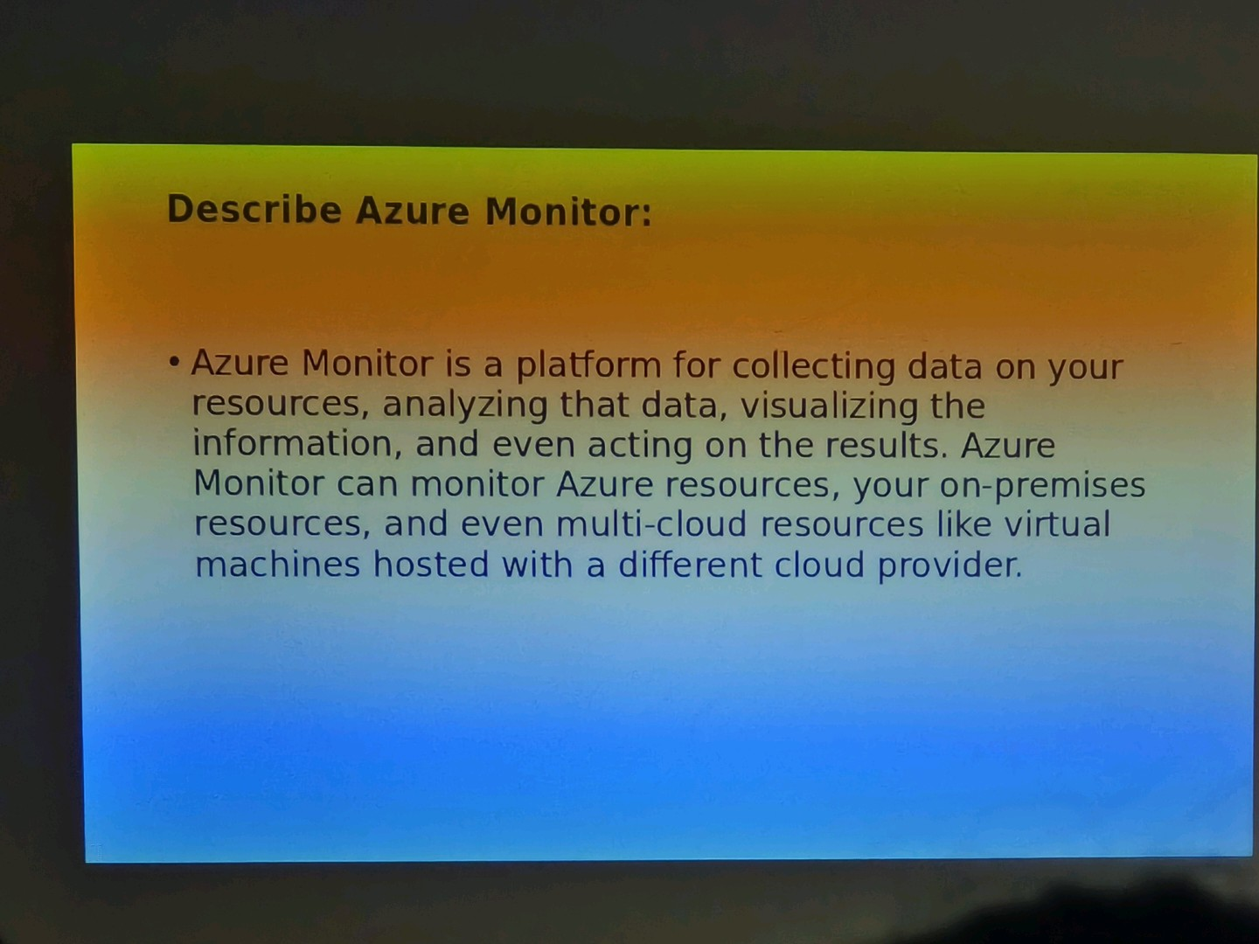

Slide 12
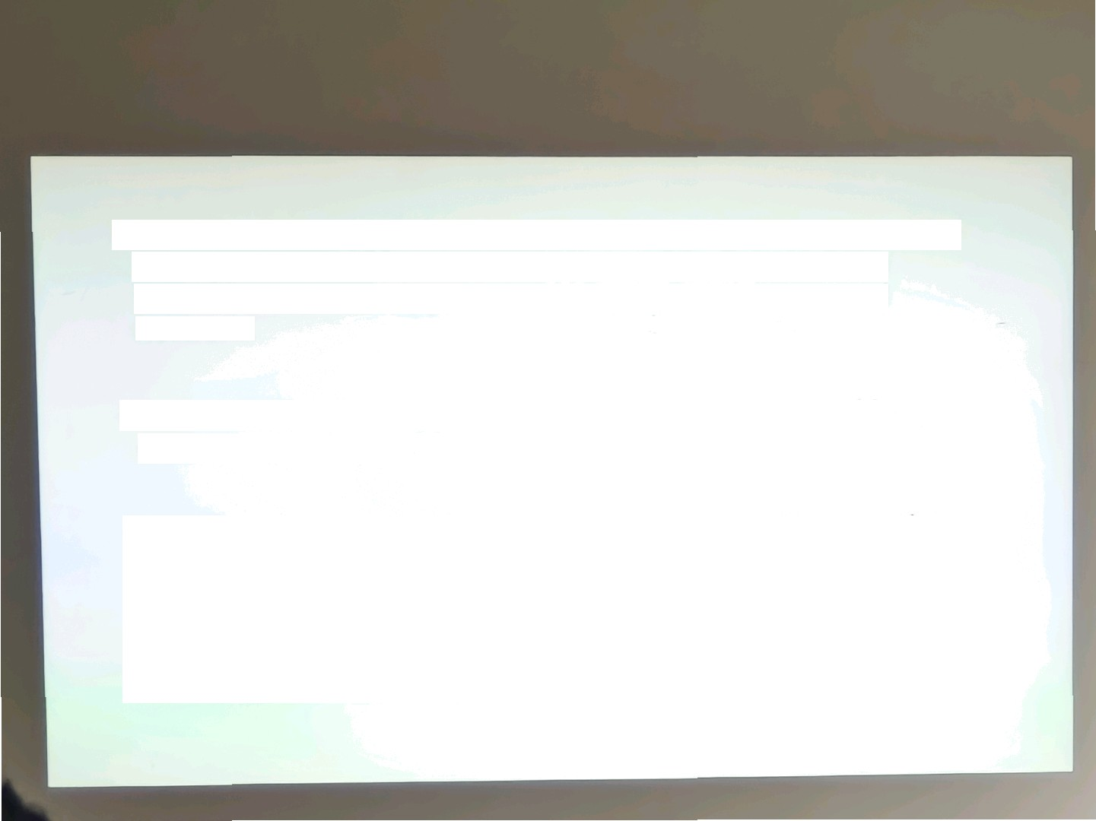
On the le6 is a list of the sources of logging and metric data that can be collected at every layer in your application axhitectue, from application to operating system and network.
In the center, the logging and metric data are stored in
central repositories.
On the right, the data is used in several ways. You can view real-timeand historical performance ac^{ross} each layer of your architecture or aggregated and detailed information. The data is displayed at di0erent levels for diPerent audiences. You can _{view high-lev}el reports oc the Azure Monitor Dashboard or
create custom views by using Power BI and Kusto ^{queries.}

Slide 13
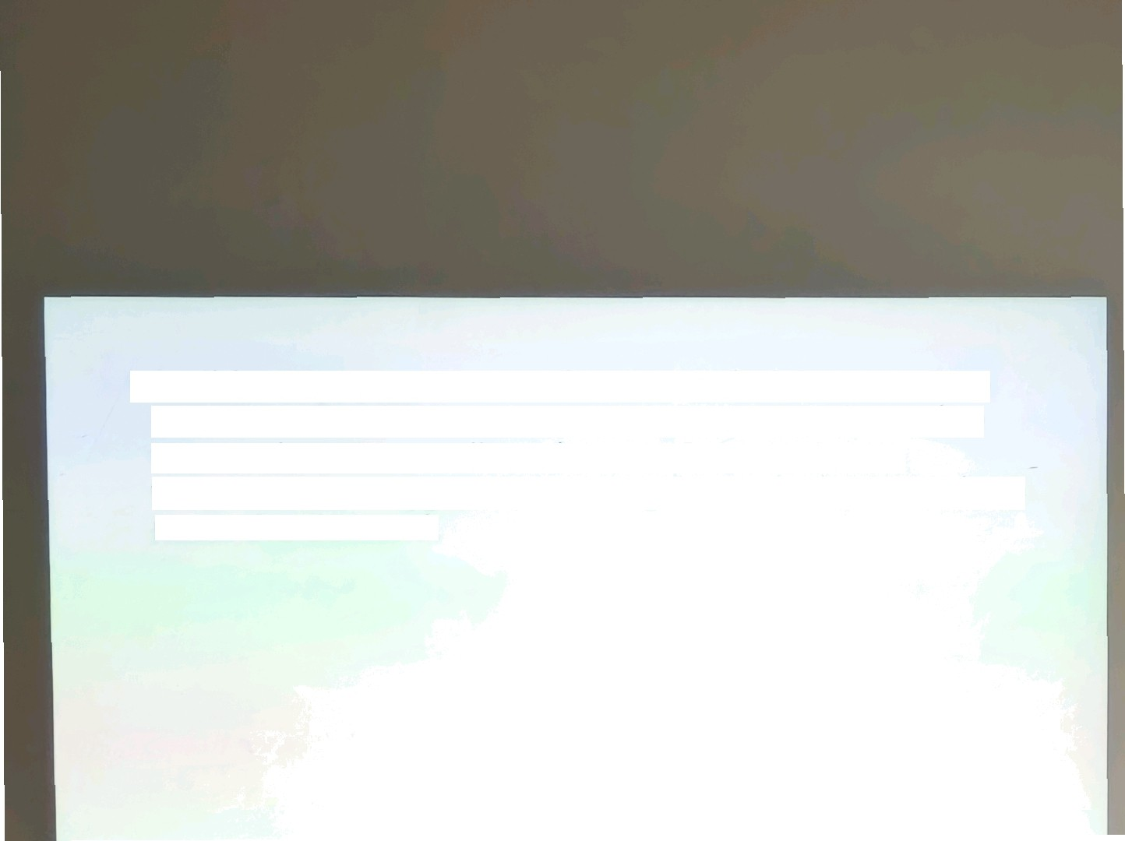
Add itionally, you ca n tise the data to hel p you react to critic a1 events in real ti nae, tlarouq h alerts de Iivored to teams v ia S t*lS, emai!, and so on. O i yo u ca n use thresholds to tr1 er aLltosC Ull13q fCll3C/ ol?c311/y /o sc3 to meet the denao nd

Slide 14
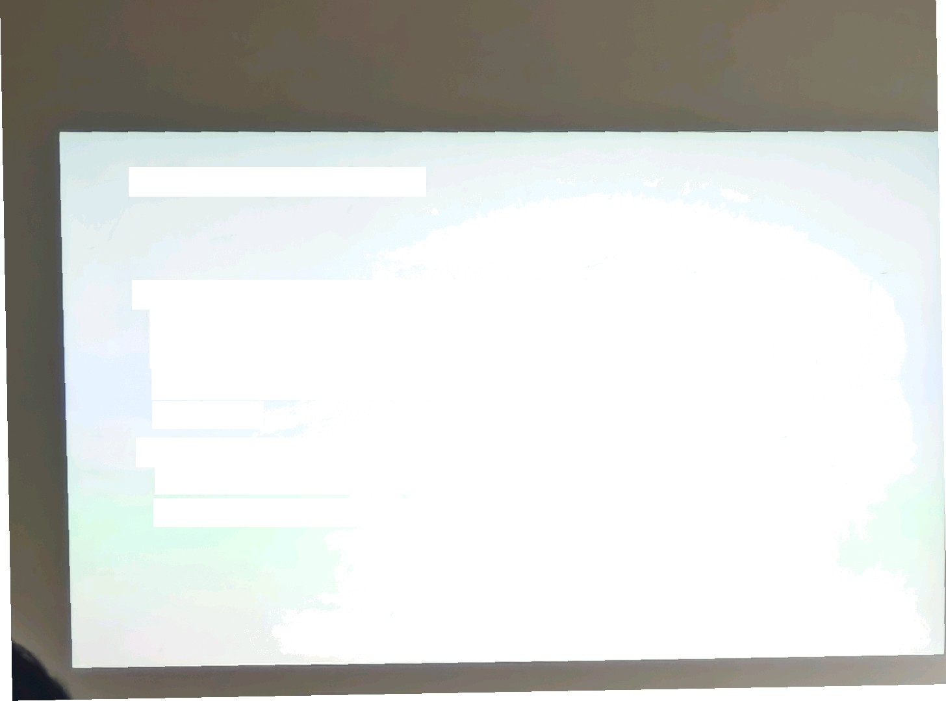
Azura Log Analytics
Azure Log Analytics is the tool in the Azure portal where you'll write and run log queries on the data gathered by Azure Monitor. Log Analytics is a robust tool that supports both simple, complex queries, and data analysis.
You can write a simple query that returns a set of records and then use features of Log Analytics IO SOf?, f1Iter, and analyze the records.

Slide 15

Azure Monitor AleHs
Azure Monitor Alerts are an automated way to stay
informed when Azure Monitor detects a threshold being
crossed. You set
the alert conditions, the notif1c ation
actions, and then Azure Monitor Alerts notif1es when an alert is triggered.
Depending on your configuration, Azure Monitor Alerts
can also attempt corrective action

Slide 16
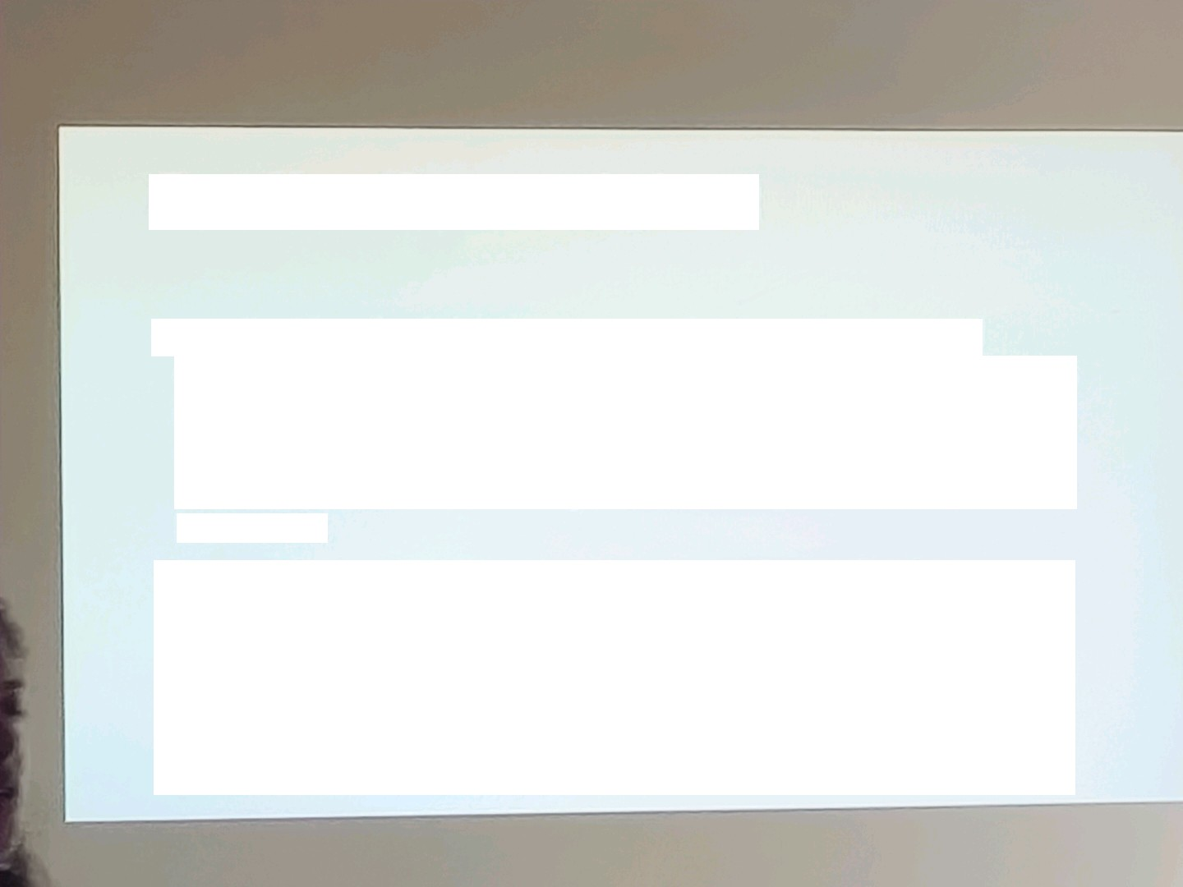
Application Insights:
Application Insights is a powerful monitoring and diagnostics tool provided by Azure. It helps developers gain insight:s into the performance and usage of their applications. With Application Insights, you can track metrics, detect and diagnose issues, and analyze user behavior.
It provides valuable data such as request rates,
response times, and error rates, allowing you to
optimize your application's performance and
_{tr}oubleshoot any issues. It's like havinga detective for
your application,helping you understand how it's
_{performing} and how users are interactingwith it.

